Slide 1
SURVEY LUNG CANCER
TEAM : STRATOS
S.Shambhavi : 2303A51832
A.Nandini : 2303A51512
A.Sri Bhuvana : 2303A51797
P.Pranay Kumar : 2303A51829
B.Srujan Kumar : 2303A51805
FACULTY : S.JAMALAIAH

Slide 2
Abstract:
Lung cancer is one of the leading causes of cancer-related deaths worldwide. It mainly affects the lungs due to uncontrolled growth of abnormal cells and is strongly linked to risk factors such as smoking, pollution, and genetic mutations. This survey aims to study the causes, symptoms, types, diagnosis methods, treatments, and prevention strategies related to lung cancer. It highlights recent advancements in early detection techniques, such as low-dose CT scans, and new treatments like immunotherapy and targeted therapies. The survey also discusses the importance of public awareness and lifestyle changes in reducing lung cancer cases. Understanding these factors can help improve survival rates and guide future research efforts toward more effective management of lungcancer.
Introduction:
Lung cancer is a serious disease that begins in the tissues of the lungs, most often in the cells lining the air passages. It is a major health concern globally, responsible for millions of deaths each year. The main risk factor for lung cancer is smoking, but other factors like exposure to harmful chemicals, air pollution, and genetic predisposition also play important roles. Lung cancer is often diagnosed at an advanced stage because its early symptoms, such as coughing and chest pain, are easily mistaken for other illnesses. Early detection is critical for better treatment outcomes. This survey explores the causes, types, symptoms, diagnostic methods, and treatment options for lung cancer. It also emphasizes the importance of prevention strategies, including smoking cessation and regular health screenings.Lung cancer is one of the most commonly diagnosed cancers and remains the leading cause of cancer-related deaths worldwide. It develops when abnormal cells in the lungs grow uncontrollably, forming tumors that can interfere with the lung’s ability to provide oxygen to the body. The disease is broadly classified into two main types: non-small cell lung cancer (NSCLC) and small cell lung cancer (SCLC), each differing in growth rate, spread, and treatment approach.Smoking tobacco is the primary risk factor, responsible for nearly 85% of lung cancer cases, but non-smokers can alsodevelop lung cancer due to secondhand smoke, air pollution, exposure to radon gas, asbestos, and genetic factors. Symptoms such as a persistent cough, chest pain, shortness of breath, and unexplained weight loss often appear only in the later stages, making early detection difficult. As a result, lung cancer frequently has a poor prognosis. Over the past few decades, advancements in imaging technologies, biomarker research, and treatment methods —including surgery, chemotherapy, radiation therapy, targeted therapy, and immunotherapy — have improved the management of lung cancer. However, early detection remains a major challenge. Efforts such as awareness campaigns, smoking cessation programs, and routine screenings are essential in reducing the incidence and mortality associated with the disease.This survey aims to provide a comprehensive overview of lung cancer, including its causes, symptoms, classification, diagnostic techniques, treatments, and preventive measures. It also highlights recent research developments and future directions in the fight against lung cancer. By understanding the disease more deeply, better strategies can be developed to improve patient outcomes and reduce its global impact

Slide 3
Methodology:
This survey was conducted to collect and analyze information related to lung cancer, its causes, diagnosis, treatments, and prevention strategies. The methodology followed a systematic approach to ensure that the data collected was accurate, up-todate, and relevant to the study objectives.
1. Data Collection:
Information was gathered from multiple reliable sources, including scientific journals, medical websites, published research papers, government health reports, and cancer organization publications such as the World Health Organization (WHO) and the American Cancer Society (ACS).
2. Selection of Sources:
Only peer-reviewed articles, authentic health portals, and recent studies (published within the last 5–7 years) were selected to ensure thequality and relevance of the information.
3. Study Approach:
A descriptive research approach was adopted. Data was studied, categorized, and summarized under various topics such as types of lung cancer, risk factors, symptoms, diagnostic techniques, available treatments, and prevention methods.
4. Data Analysis:
The information collected was critically analyzed to identify patterns, recent trends, and advancements in lung cancer research. Statistical dataregarding incidence rates, survival rates, and the effectiveness of different treatments were reviewed.
5. Limitations:
This survey is based on secondary data sources. No direct clinical trials or patient interviews were conducted. Therefore, the findings depend on the accuracy of the referenced materials.
Results and Discussion:
He survey found that lung cancer continues to be a major health concern worldwide, especially in developing and industrialized countries. Data shows that lung cancer accounts for approximately 18% of all cancer-related deaths globally. Smoking remains the leading cause, but factors like exposure to air pollution, radon gas, occupational hazards (such as asbestos), and genetic predisposition also significantly contribute.It wasobserved that Non-Small Cell Lung Cancer (NSCLC) accounts for nearly 85% of all lung cancer cases, while Small Cell Lung Cancer (SCLC)islesscommon but more aggressive. Early symptoms of lung cancer, including persistent cough, shortness of breath, and chest pain, areoften ignored or mistaken for less serious illnesses, leading to late-stage diagnoses in many cases

Slide 4
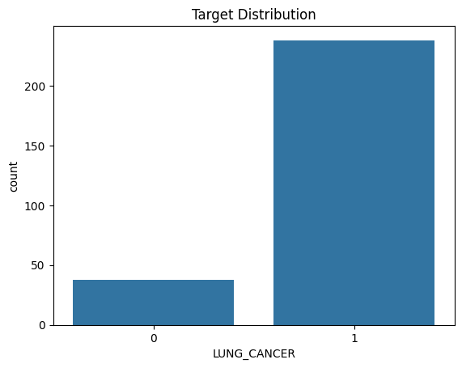
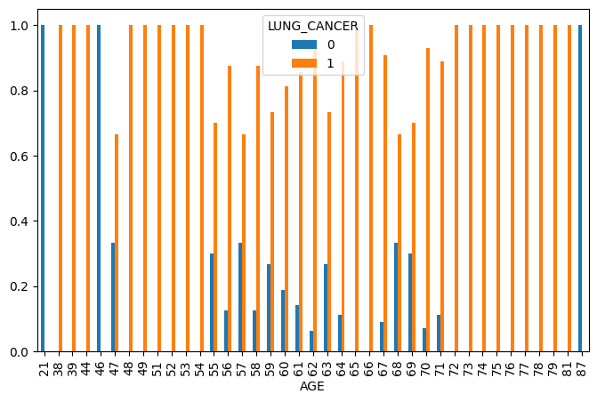

Slide 5
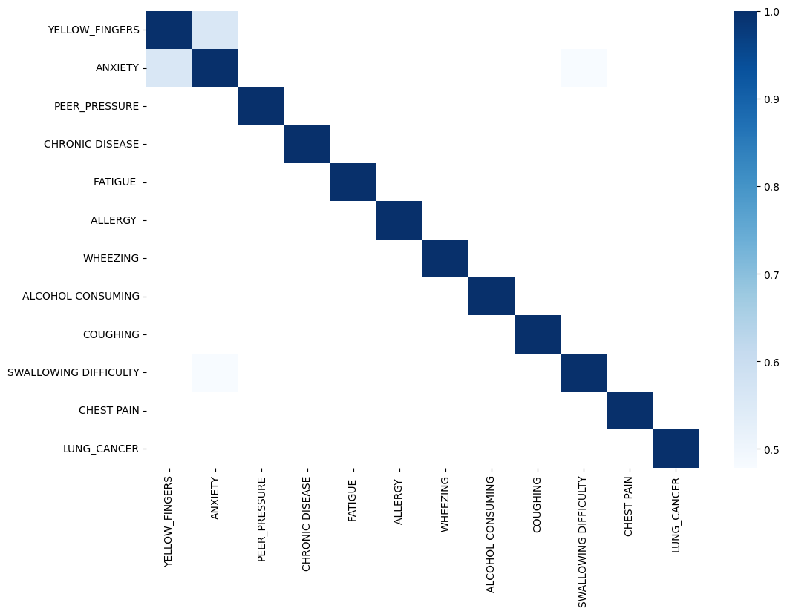
Precision recall f1-score support
0 0.95 0.98 0.97 64
1 0.98 0.95 0.96 56
accuracy 0.97 120
macro avg 0.97 0.97 0.97 120
weighted avg 0.97 0.97 0.97 120

Slide 6
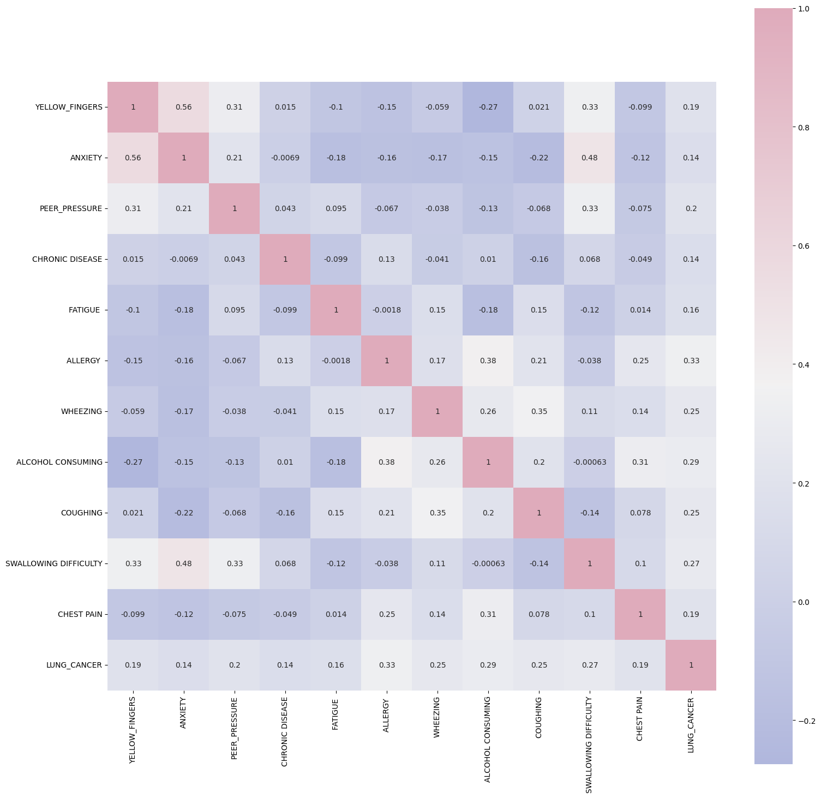

Slide 7
Confusion Matrix Analysis:
The confusion matrix is a 2x2 table that compares the predicted class and the actual class of each instance in the test set.The four main components of the confusion matrix are:
1. True Positive (TP):
These are the instances where the model correctly predicts the positive class (e.g., correctly predicting that a patient has lung cancer). In a medical context, a true positive means the model correctly identifies a patient as sick.
2. True Negative (TN):
These are the instances where the model correctly predicts the negative class (e.g., correctly predicting that a patient does not have lung cancer). A true negative means the model correctly identifies a healthy patient.
3. False Positive (FP):
These are instances where the model incorrectly predicts the positive class (e.g., predicting that a healthy patient has lung cancer). This is also called a Type I Error. A false positive can have severe consequences, especially in medical diagnoses, where it might lead to unnecessary treatment.
4. False Negative (FN):
These are instances where the model incorrectly predicts the negative class (e.g., predicting that a patient with lung cancer is healthy). This is also called a Type II Error. A false negative is dangerous in medical applications because it means failing to detect the disease, leading to missed treatment opportunities.

Slide 8
CODE: https://github.com/2303a51832/DataMining/blob/main/SurveyLungCanb.ipynb
References:
American Cancer Society (ACS). (2023). Lung Cancer. Retrieved from
https://www.cancer.org/cancer/lung-cancer.html
World Health Organization (WHO). (2021). Lung Cancer. Retrieved from
https://www.who.int/news-room/fact-sheets/detail/cancer
National Cancer Institute (NCI). (2022). Lung Cancer Overview. Retrieved from
https://www.cancer.gov/about-cancer/types/lung
Jemal, A., Bray, F., Center, M. M., Ferlay, J., Ward, E., & Forman, D. (2011).
Global cancer statistics. CA: A Cancer Journal for Clinicians, 61(2), 69–90. DOI:
10.3322/caac.20107
Pereira, M. A., Pissarra, C., & Costa, S. (2020). Recent Advances in Lung Cancer
Diagnosis and Therapy. Lung Cancer Management, 58, 32–45.

